Slide 1
Increase yield
Monitor pollinator populations
Reduce loss
Apply appropriate pesticides
Promote beneficial insects
Protect the Earth
Limit pesticide applications
Identify new threats
Insect pollination provides the UK a benefit worth £690 million per year¹
Insect-borne diseases like CYD can cause up to 33% yield loss in barley²
Agricultural Goals
Invasive species cost the UK economy £1.7 billion per year³
Notes:
References:
1 University of Reading Centre for Food Security https://www.reading.ac.uk/web/files/food-security/CFS_Case_Studies_-_Sustainable_Pollination_Services.pdf
2 Walls, J., Rajotte, E. and Rosa, C., 2019. The past, present, and future of barley yellow dwarf management. Agriculture, 9(1), p.23.
3 The Economic Cost of Invasive Non-Native Species on Great Britain. CABI. 2010. http://www.nonnativespecies.org//index.cfm?sectionid=59

Slide 2
Webapp features - Summary
Identify and map images taken from farmland to relevant matching known (plant/insect/species/pest) species names with time and location (with detailed co-ordinates) stamp
Store information collected and use to accumulate and monitor movement of species over time in terms of direction, volume/concentration, speed
This functionality can be used to manage post control in a proactive manner and hence eliminating or at least significantly reducing crop damage and related costs for the farmers.

Slide 3
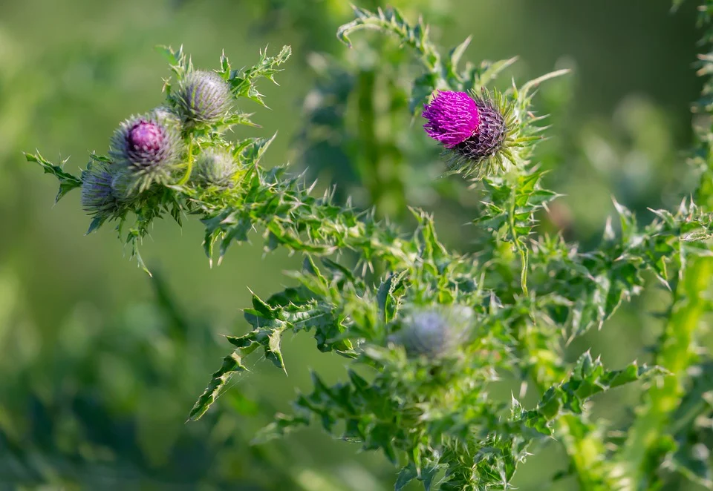
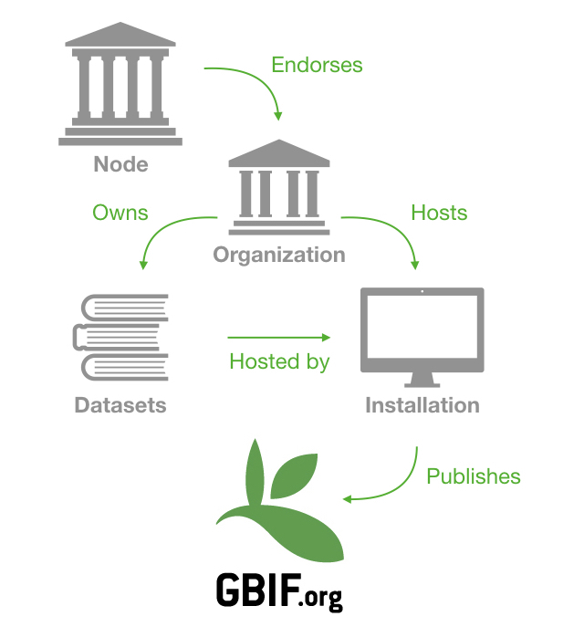
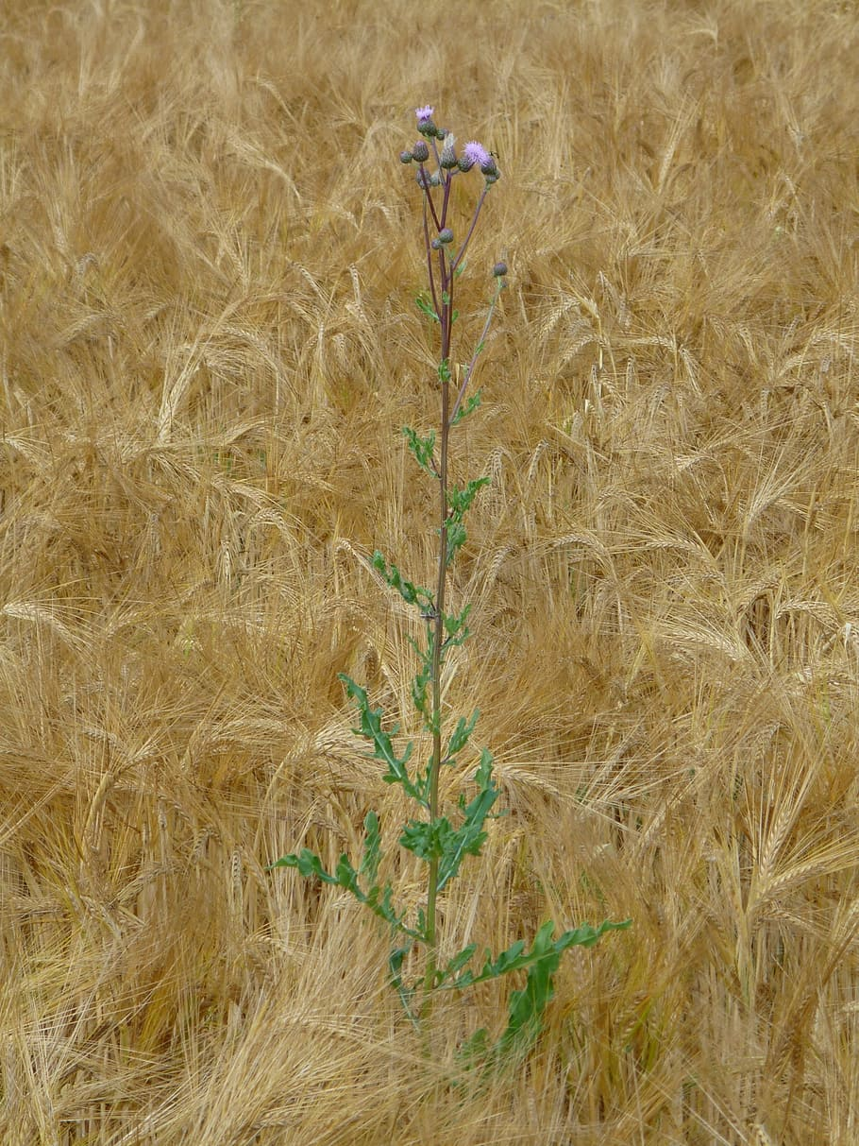
Product & features
Identify plant species via image recognition
Retrieve latest scientific data from international databases
Store and view a map of all your observations
Analyze invasive species movements over time
https://data-blog.gbif.org/post/installations-and-hosting-solutions-explained/

Slide 4
Unique Value Proposition
 | PlantMap | PictureThis (Glority) | Picture Insect: Bug Identifier (Glority) | iNaturalist | Our app
Species Recognition:
Plants | Manual¹ | x |  | x | x
Insects |  |  | x | x | x
Location Mapping | x | Community Sharing | Community Sharing | Community Only | x²
Tiers | Basic/Premium | Free/ Subscription | Free/ Subscription
Desktop | x | x |  | x | x
Mobile |  | x | IOS only
Actionable Suggestions |  |  |  |  | x
1 – Search and pick closest species from community database or add new entry manually
2 – Farmland/local level

Slide 5
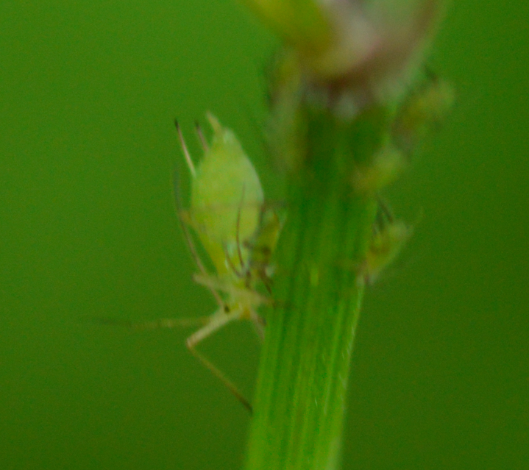
Farmer surveys field, uploads pictures of what he sees
FarmSmart
Stores picture data
Identifies species
Extracts and maps geolocation
Plots metrics
Classification (Friend vs Pest)
Abundance
Change through time
Farmer makes an informed decision about treatments
Photo by sbushes on iNaturalist.org CC BY-NC 4.0

Slide 6
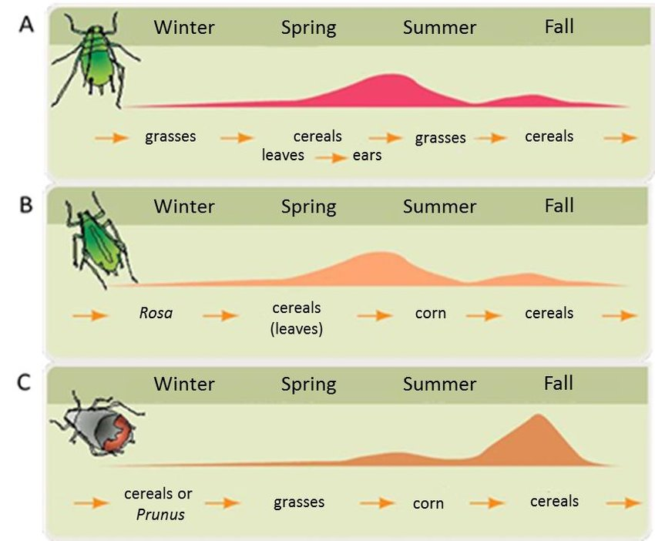
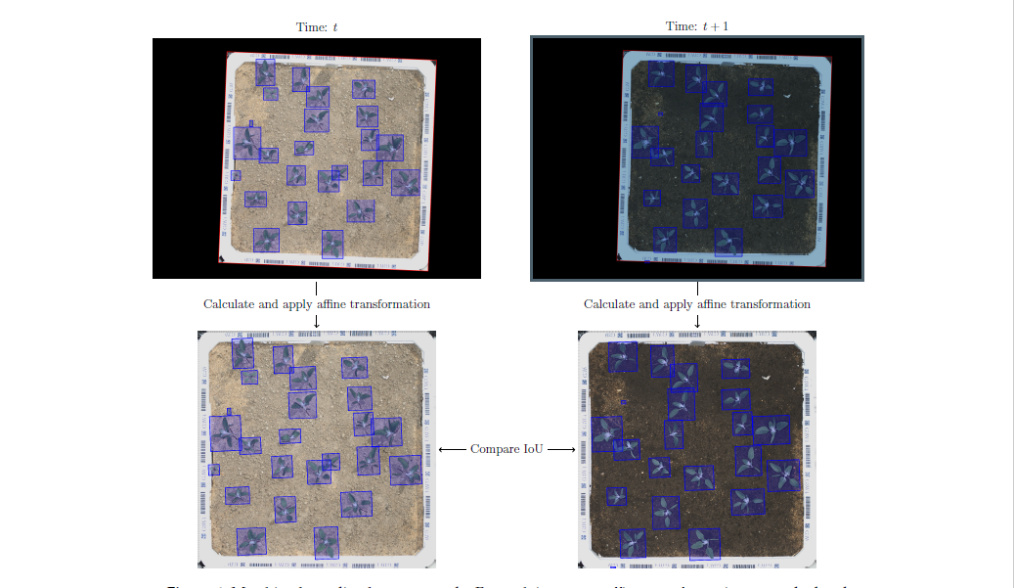
Screenshots

Slide 7
Market and Future Directions
Precision agriculture

Slide 8
Existing Tech
Tools to identify species
Glority (www.glority.com)
PictureThis (www.picturethisai.com)
Tools to learn about pests
Croprotect (croprotect.com)
CABI's Plantwise Factsheets Library (www.cabi.org/isc/datasheet)

Slide 9
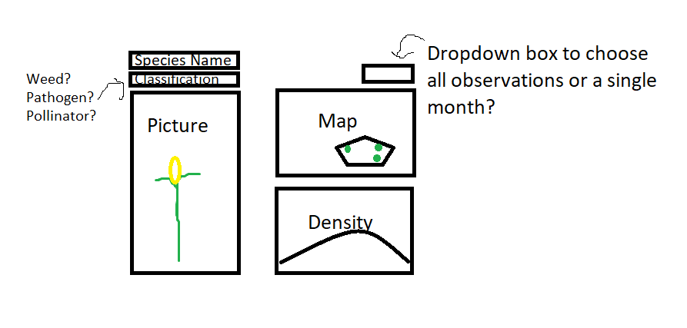

Slide 10
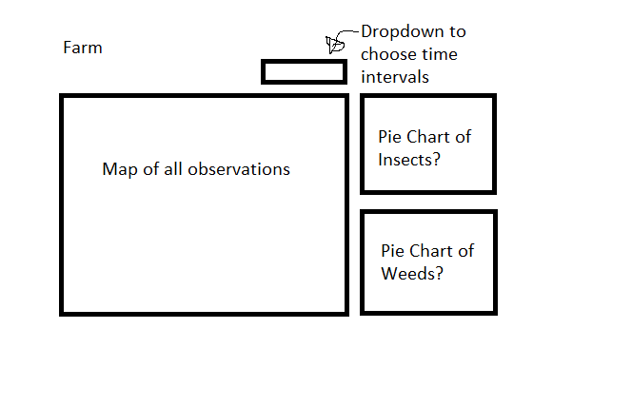

Slide 11
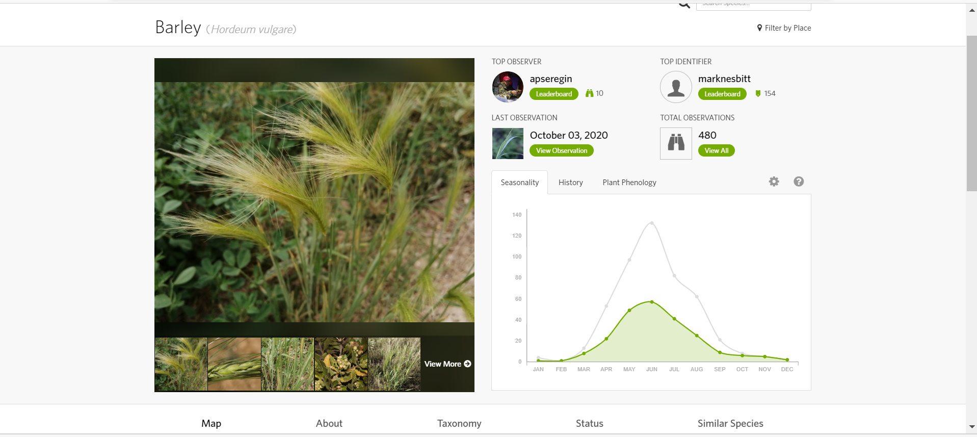
Example of species information on Webapp
Notes:
https://www.inaturalist.org/taxa/57182-Hordeum-vulgare

